Slide 2
ApprenticeshipNC Registration Agency
The N.C. Community College System, ApprenticeshipNC, is the State Agency to register programs for Federal purposes.
Guarantor of Quality for apprenticeship programs
ApprenticeshipNC promotes, develops, registers and assists in the operation of registered Apprenticeship and other training programs throughout the state.

Slide 4
High School Pre-apprenticeship to Apprenticeship Model
This model is unique to North Carolina
Developed in the 1980-90’s by European Executives
“Apprenticeship2000” first apprenticeship consortium
Spread rapidly across the state in the past 3 years
15 established consortia
13 forming consortia
8 large independent programs

Slide 5
http://www.apprenticeshipnc.com

Slide 6
What is a Consortium Apprenticeship Model?
Industry Sector Partnership
Workforce Development Partnership

Slide 7
What is an Independent Model?

Slide 8
Connecting Apprenticeship to Local Stakeholders
August
Begin working with your local economic partners like the EDC, Chamber of Commerce or Economic Development at your Community College to gain local supporters of apprenticeship.
September | October | November | January | February | March | April | May-June | August-February
Awarenes Business Advisory K-12 and Community College Chamber Meetings Industry Associations Community Groups | Send out surveys to determine interest in a second meeting | Convene a summit with interested companies and ApprenticeshipNC Representatives Organize attendees by Industry Sector Collect Commitment Cards and share them with ApprenticeshipNC | Convene a 2nd meeting with interested companies Determine if there will be a consortium Determine if there will be independent programs Select an Industry Champion Select Future Meeting Dates | Begin creating local apprenticeship guidelines and program plans for recruiting and marketing Begin working with the community college on related education | Begin registering programs with ApprenticeshipNC |  | Create a Marketing materials and marketing plan | Deploy Marketing to K-12 teachers, support staff students, and parents

Slide 9
Promoting the Benefits of Apprenticeship to Industry
Increased retention and low turn over for the duration of the apprenticeship and beyond decreases company training costs
The end result of the career pathway and opportunity for leadership and advancement within the company/industry

Slide 10
Return on Investment
“Youth have or can easily obtain the pre-requisite skills you want to bring into your company.”
Math skills and pre-requisites
Industry Certifications
Credentials
Safety & Training
Students are eligible for a community college tuition waiver when youth are registered as a pre-apprentice or apprentice before graduation

Slide 11
Promoting the Benefits of Apprenticeship to Parents and Students
Students can earn while they learn
No college debt
Guaranteed or preferential job placement
Nationally recognized and stackable credentials

Slide 12
Promoting the Benefits of Apprenticeship to Community Organizations
Companies can partner with youth serving organizations who can pay for on-the-job learning for eligible students (example: WIOA)
Some chambers of commerce serve as fiduciary partners to apprenticeship programs
Goodwill often hosts related education programs
Vocational Rehabilitation can provide paid internships to graduates that

Slide 13
Youth Recruitment Model

Slide 14
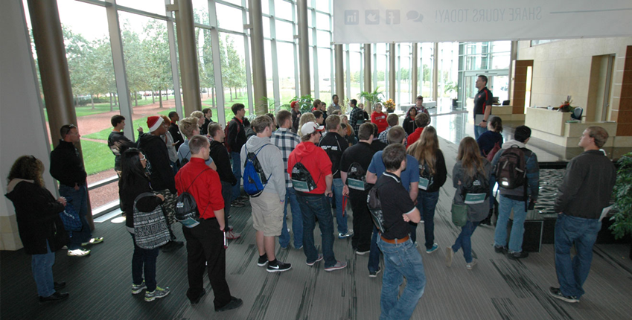
Recruitment Activities
Plant tours on a Saturday (Open House)
Students and parent or guardian must attend plant tour
High School campus visits and presentations by industry

Slide 15
Applicant Review
Created and distributed to schools by the company or consortium and used to select students for the orientation

Slide 16
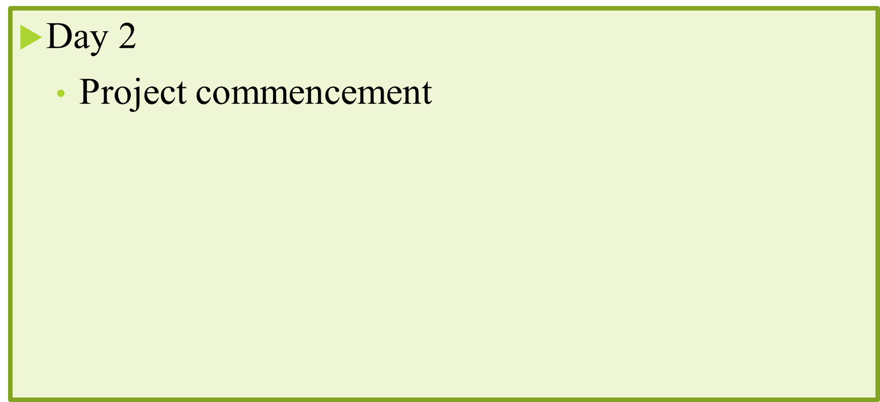
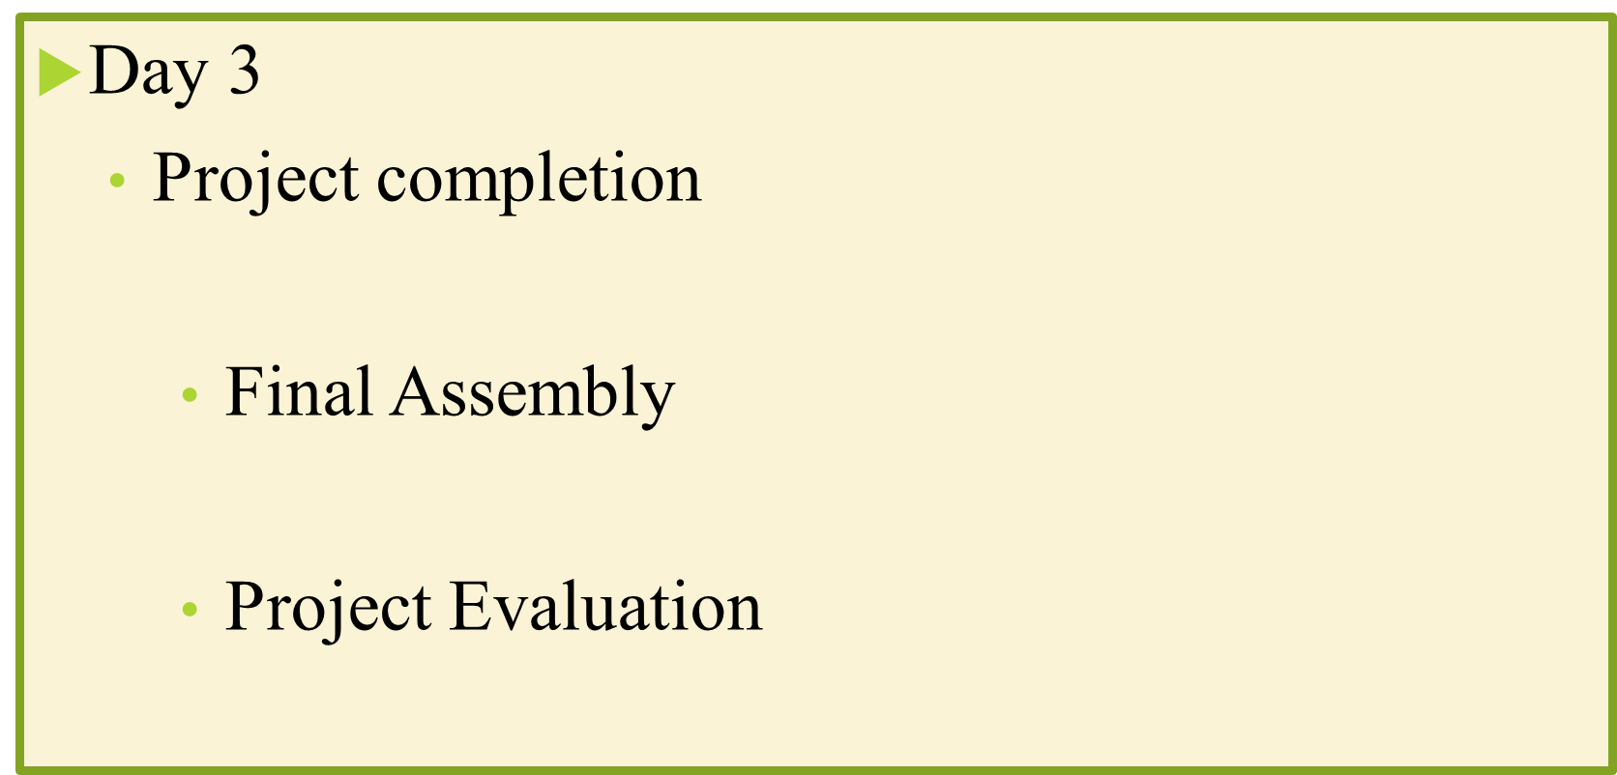
Orientation/Testing

Slide 17
Ranking
The apprenticeship committee convenes to rank students and determine who will be invited to participate in a pre apprenticeship.

Slide 18
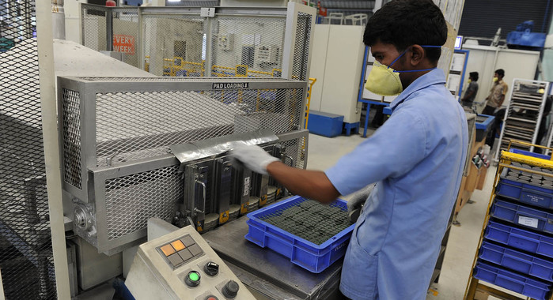
Pre-Apprenticeship Example
6 Week long summer experience
2 Classes at Community College
Industry Safety (30 hour OSHA)
Intro Course
Employer placement for on-the-job learning through out the company

Slide 19
Tuition Waiver:
Prior to HS graduation, students must be registered in either a Pre-Apprenticeship or Registered Apprenticeship program…and…
Within 120 days of HS graduation, student must be enrolled in their community college coursework

Slide 20
Signing Ceremony
Sponsors host a signing ceremony
Parents and dignitaries are invited
Students sign a letter of commitment

Slide 21
What is Registered Apprenticeship?
Apprenticeship is a system of work based learning designed to meet the needs of the employer by providing the employee with structured on-the-job learning and job related education.

Slide 22
Four Components of a Registered Apprenticeship
On the Job Learning
Job-related Education
Progressive wage scale
Apprenticeship Standards
1. Organized written plan of the terms and conditions of employment
of the apprentice.
2. Determines the occupation
3. The length of time
4. Type of training
(time-based,
competency-based,
or hybrid approach)

Slide 23
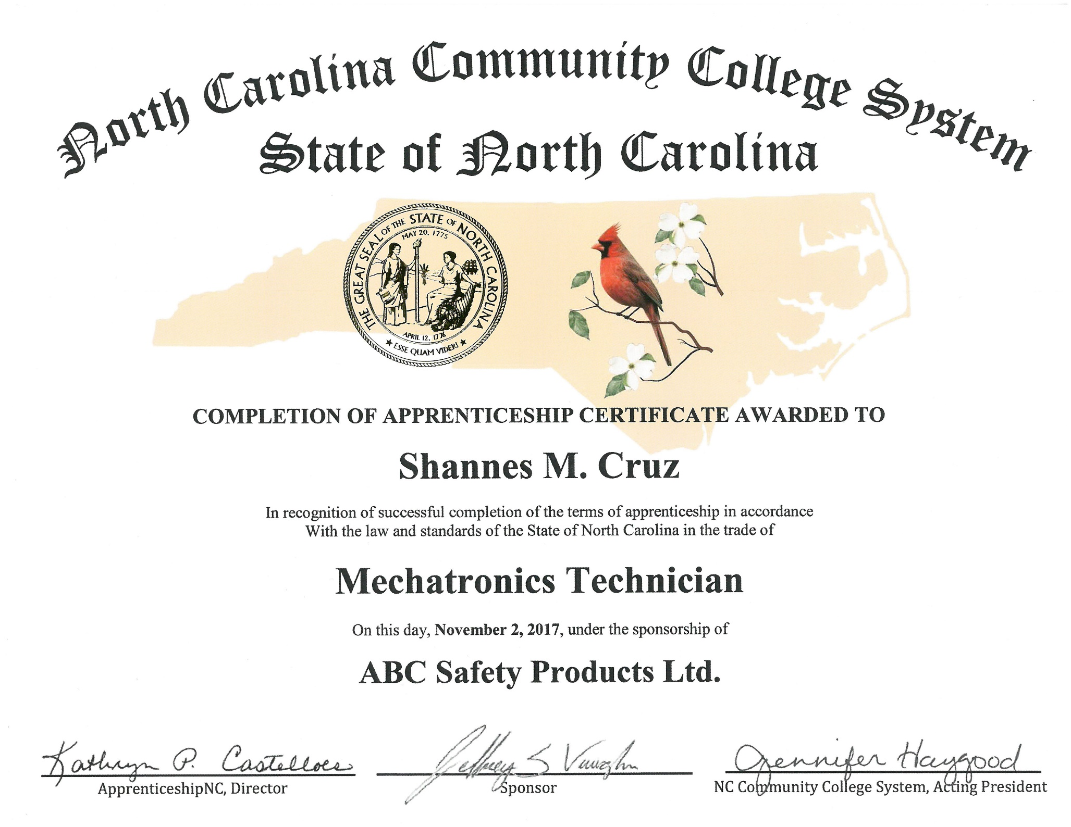

Slide 25
Dr. Elizabeth Standafer, ApprenticeshipNC Youth Coordinator standafere@nccommunitycolleges.edu 919-414-5948

