Slide 1
Advanced Manufacturing review
Northeast NC Career Pathways

Slide 2
Manufacturing Is Not Dead
Highlights
Manufacturing has added nearly one million new jobs since the end of the recession. A growing share of these jobs require postsecondary education.
Domestic manufacturing increasingly behaves like a high-tech industry in that it needs a smaller, specialized workforce.
Employers need workers who blend traditional production skills (machining, welding, fabrication technologies) with engineering skills (process improvement, quality assurance, design).
Workers who successfully blend these skills receive higher wages and, perhaps more importantly, can move up the career ladder in their companies or transition to other industries.

Slide 3
NENC Pathways Updates
Advanced Manufacturing Annual check-in
Website/Social Media
Constant Contact
Marketing
BSS Application (Due 3/22 for May 2018 Certification)
Local Implementation
Focus on Local
Metrics

Slide 4
Community College Measures

Slide 5
Community College Measures

Slide 6
Workforce Development Board Measures

Slide 7
Workforce Development Board Measures

Slide 8
LEAs (Local Education Agency) Measures

Slide 9
LEAs (Local Education Agency) Measures

Slide 10
Industry Spotlight
Paul McClellan
Plant Manager

Slide 11
Keith Horne
Industrial Systems Technology

Slide 12
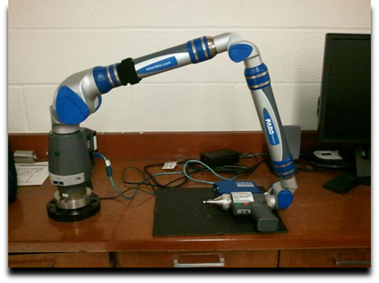
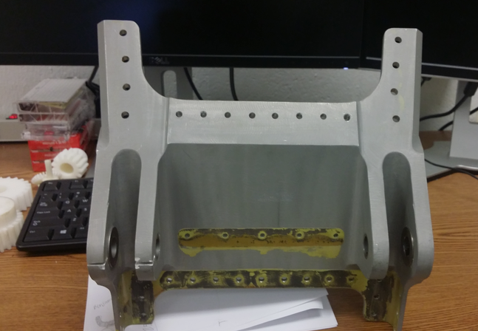
Integrating Reverse engineering, 3d Printing, and CNC for Advanced Manufacturing processes
Akbar Eslami
Elizabeth City State University

Slide 13
objective
Utilize the FARO arm and the Geomagic Studio software
Scan the object using the FARO arm and convert the point clouds into a 3D-CAD model
Use 3D printing for prototyping the part
Complete stress analysis
Generate a G-code needed to operate CNC machine

Slide 14
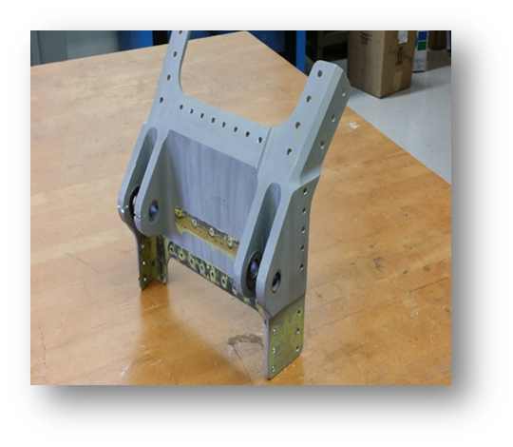
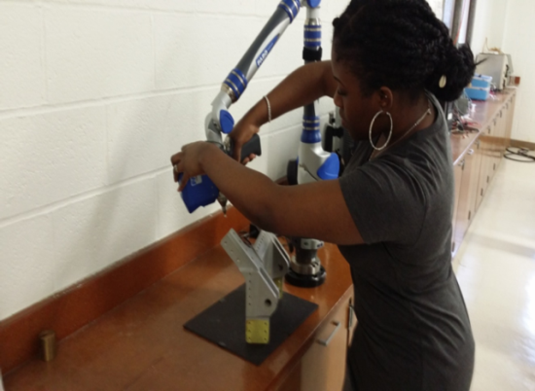
Process of scanning
Using the FaroArm, and Geomagic software to scan and transform geometry of a part of airplane wing into a useful three-dimensional (3D) computer model platform
Scanning the top part of the object as shown.

Slide 15
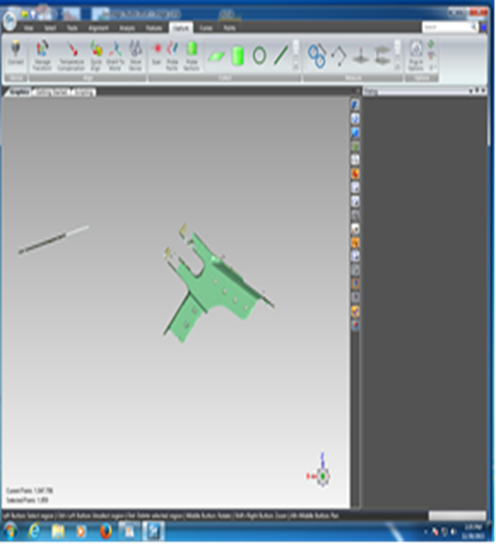
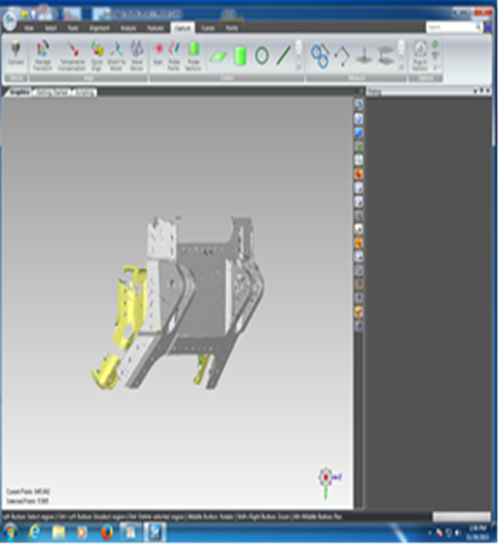
Due to the complexity of the part, it was scanned in pieces.
Point clouds of front section. The yellow indicates the software is in process of converting points to computer model
Point clouds of top section
Point clouds of front section

Slide 16
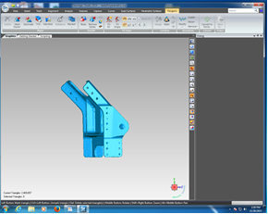
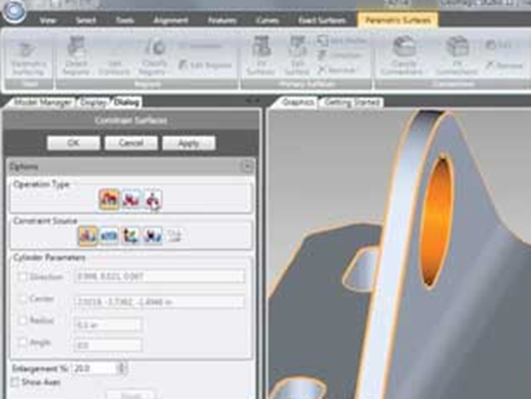
Side and back of the part after finishing scanning and merging all pieces of the part together to create one solid piece
Preparing scan model for CAD conversion by going through the process of Parametric Surfacing

Slide 17
Converting from computer model to CAD model

Slide 18
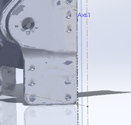
Fixing the holes in the part
Fully converted computer model into CAD model from geomagic to SolidWorks
Fixing the holes

Slide 19
CAD Model

Slide 20
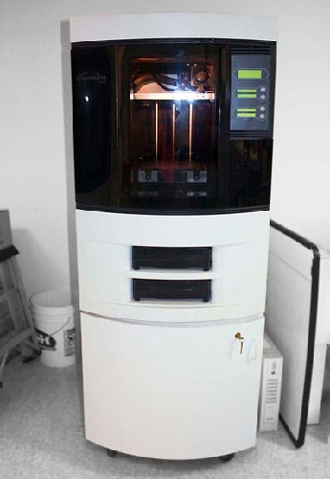
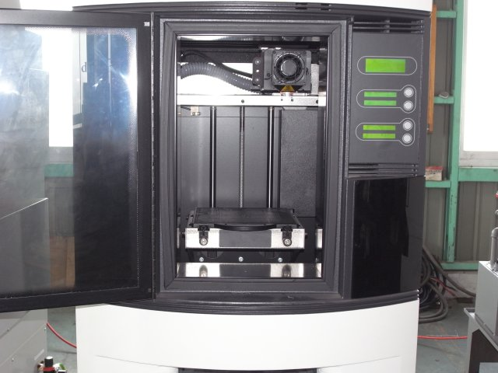
3d printing
The Dimensions inside were 10 in x 11in
The Dimension 768 3D printer

Slide 21
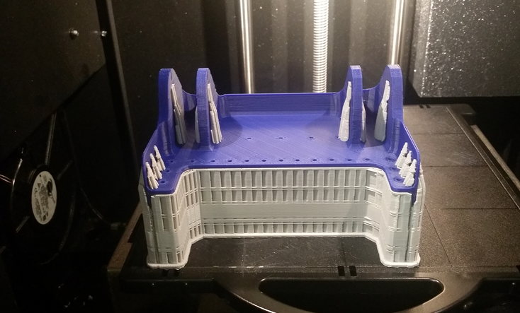
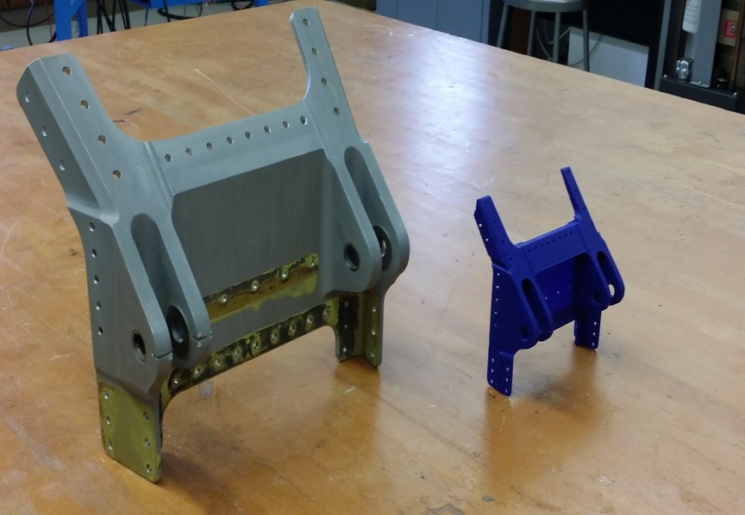
Printing the part
The process began by creating cross-sections of material layer by layer until the 3D model is complete
Because the original part was so big, the prototype was scaled down 50%

Slide 22
Stress analysis
Step 1: Creating a Mesh
Step 2: Simulating Von Mises stress values
Step 3: View Displacement
SolidWorks simulation software is utilized for stress analysis of the part.

Slide 23
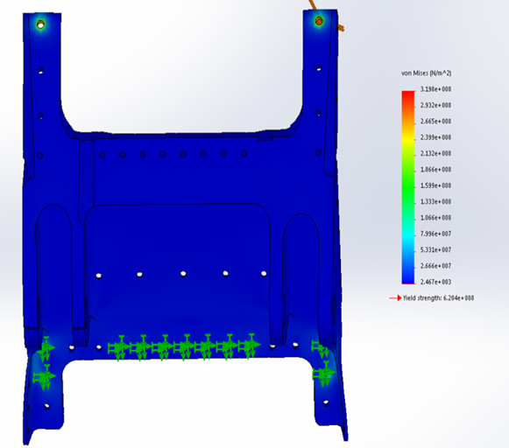
Von Mises STRESS ANALYSIS
Using the Von Mises method
Checking whether the part will withstand a given Load condition.
The 3000lbs force is applied.

Slide 24
Von Mises Stress ANALYSIS
The stress analysis indicates the part can handle desired stress in working conditions.
Performing stress analysis results in improvement and performance of the part.

Slide 25
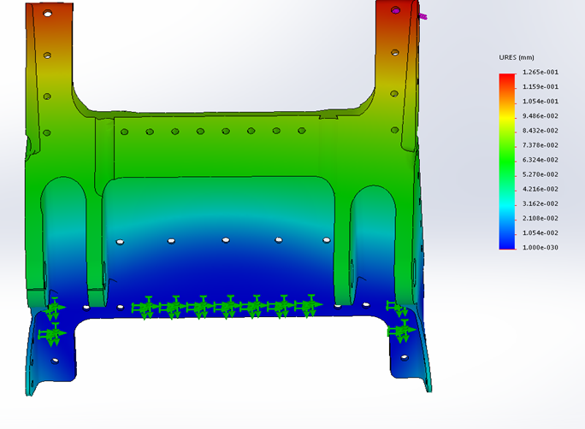
displacement
Shows which sections obtained the most deflections

Slide 26
Generating g-code
Use Mastercam X9 for SolidWorks software.
Step 1: Select tools and surfaces
Step 2: Create Tool paths
Step 3: Simulate

Slide 27
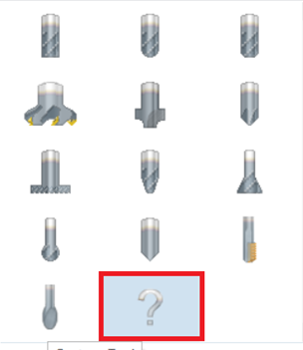
Select tools and surfaces
The Mastercam for SolidWorks software is exploited to generate the G-code for machining the part by a CNC machine.
Due to some technical issues and complexity of the part including machining front and back of the part, a sole G- code for entire of the part was not created successfully. The solution was to cut the part to two pieces and generate two G codes for them separately.
Defined origins on top corners
Tools selected:
¾ Spot Drill to drill the holes
½ Flat End Drill to create the main features.
¾ Chamfer Drill to create the surface curves.

Slide 28
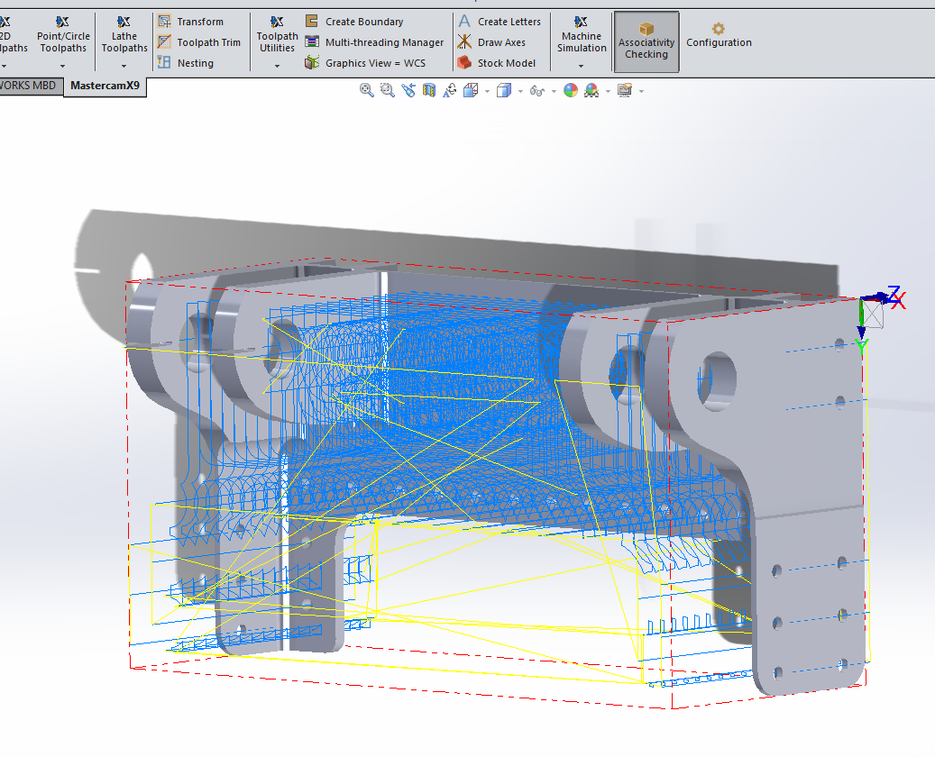
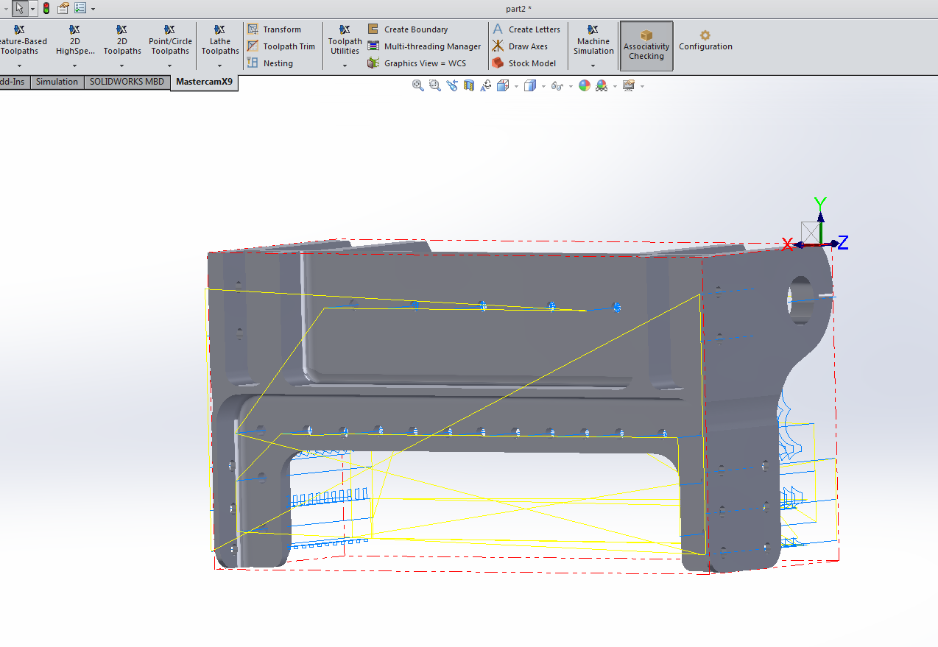
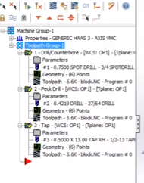
Create Tool paths
Front Toolpath
Back Toolpath
Toolpath instructions

Slide 29
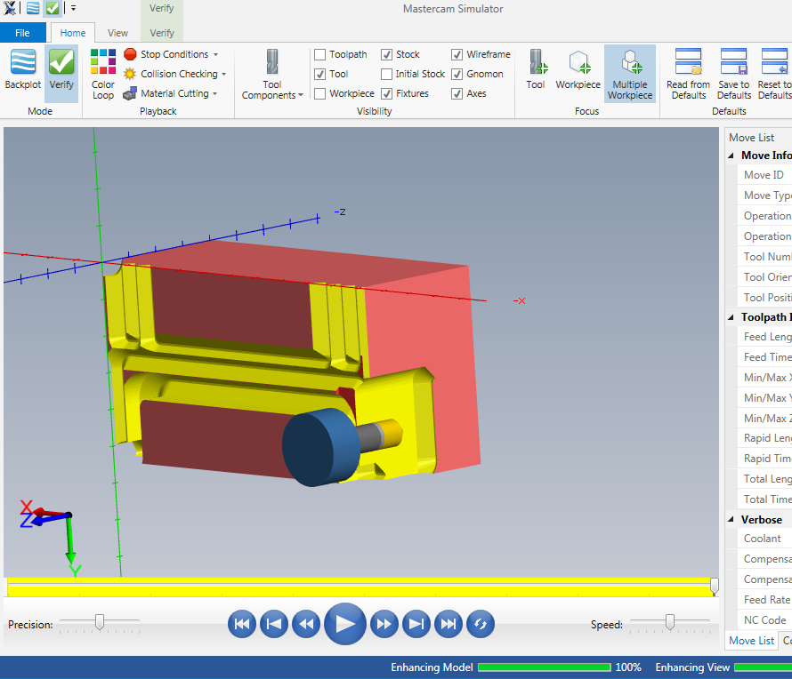
Simulating and Generating g-code

Slide 30
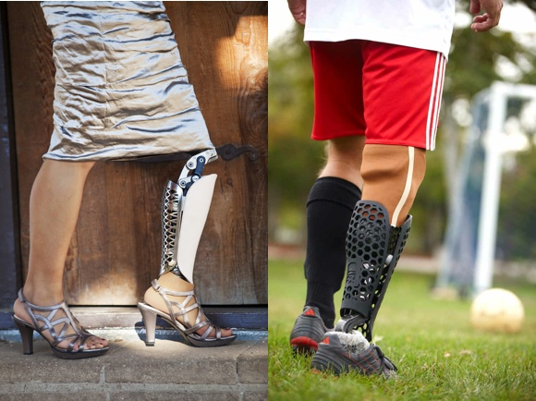
Project Impact
Using the reverse engineering arm/3D scanner and 3D printer are very popular in many sectors of industry including military, NASA, healthcare, and education.
3D printing and stress analysis are used to improve performance, reliability, and affordability.
This process can be used to redesign a part, and inspect geometry, as well as validate measurements of the part.

Slide 31
Conclusion
This project proves that the reverse engineering process is a reliable and efficient method for transferring geometry of an outdated part into a useful 3D computer model. 3D printer is then used to manufacture the part and stress analysis is performed to improve reliability and ensure this part can be used for real world application.

Slide 32
question

Slide 34
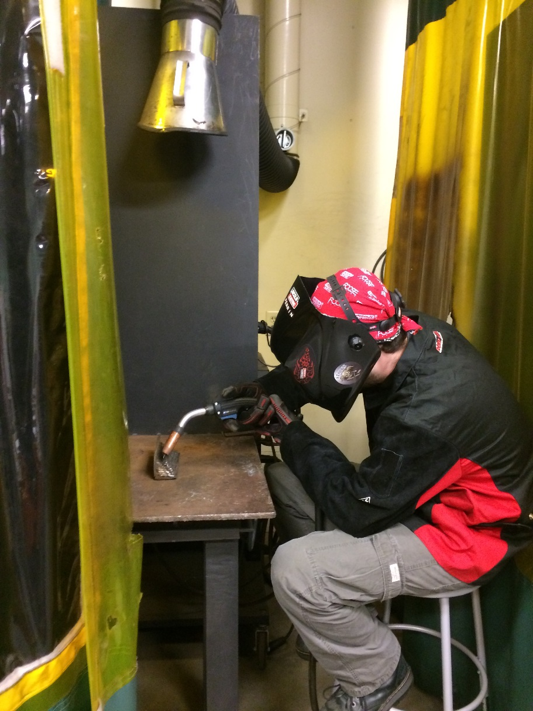
DARE COUNTY SCHOOLS
Dare County Schools student James Perrin taking welding class at College of the Albemarle.

Slide 35
BERTIE EARLY COLLEGE HIGH SCHOOL

Slide 36
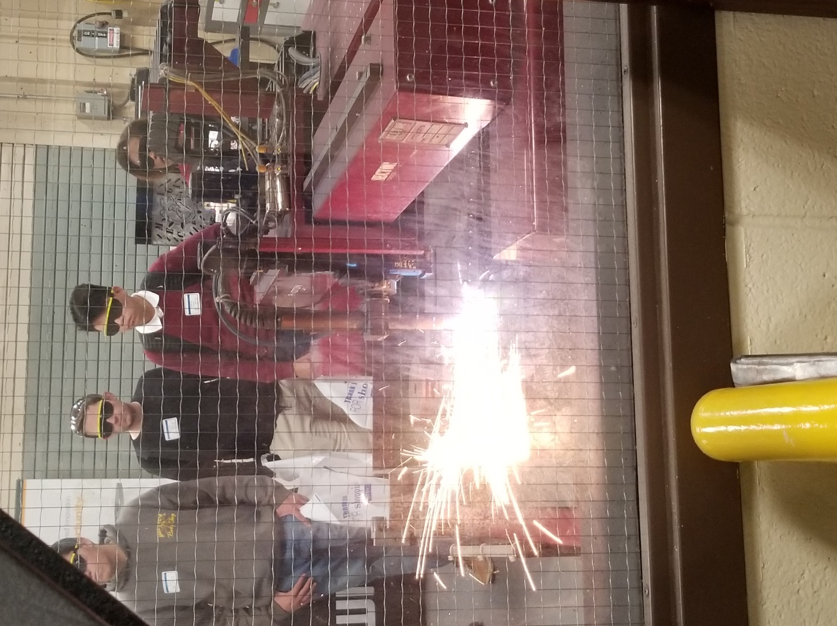
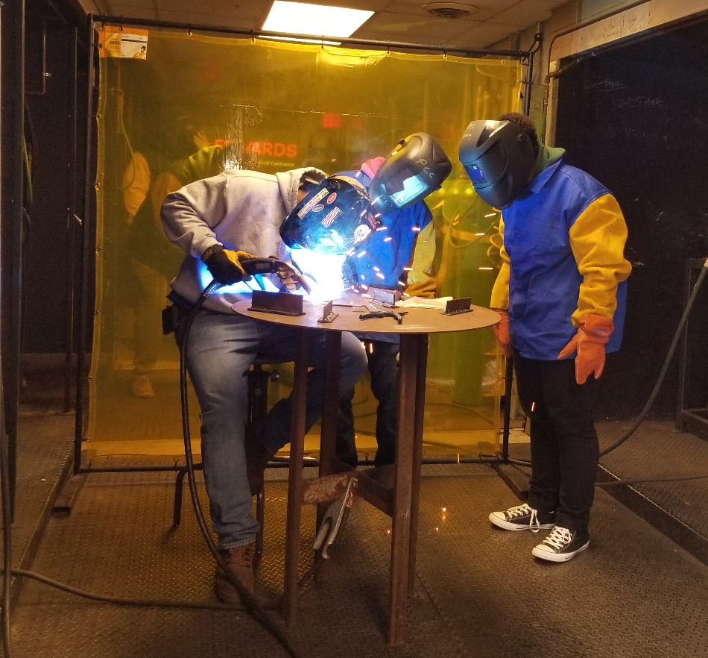
PITT COMMUNITY COLLEGE

Slide 37
ELIZABETH CITY PASQUOTANK PUBLIC SCHOOLS

Slide 38
MARTIN COMMUNITY COLLEGE

Slide 39
COLLEGE OF THE ALBEMARLE

Slide 40
NASH COMMUNITY COLLEGE

Slide 41
PERQUIMANS COUNTY SCHOOLS
Hooked on Advanced Manufacturing: Lure, Snags, and Catches of a Local Collaboration
How do you catch the big one? You assemble the local fishermen on one boat and dangle the lure. Join the discussion on how to assemble your local stakeholders, create an advanced manufacturing pathway, and reel in community benefits. A team of workforce development professionals, state education agency representatives, local community college liaisons, and local Career and Technical Education directors has worked together to snag big benefits for students.

Slide 42
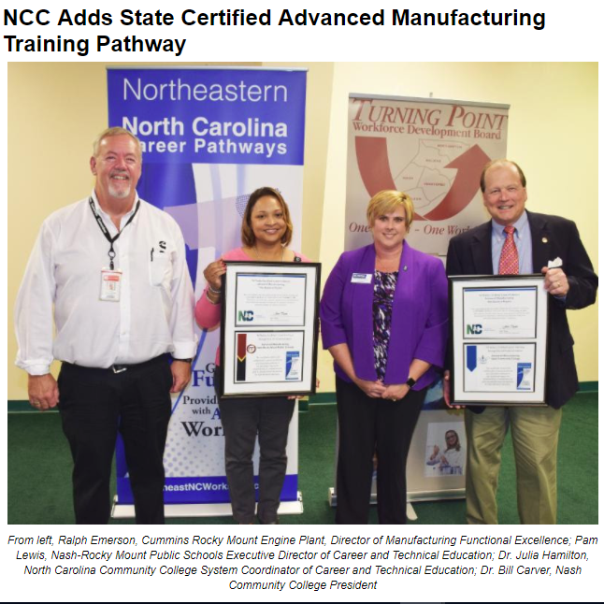
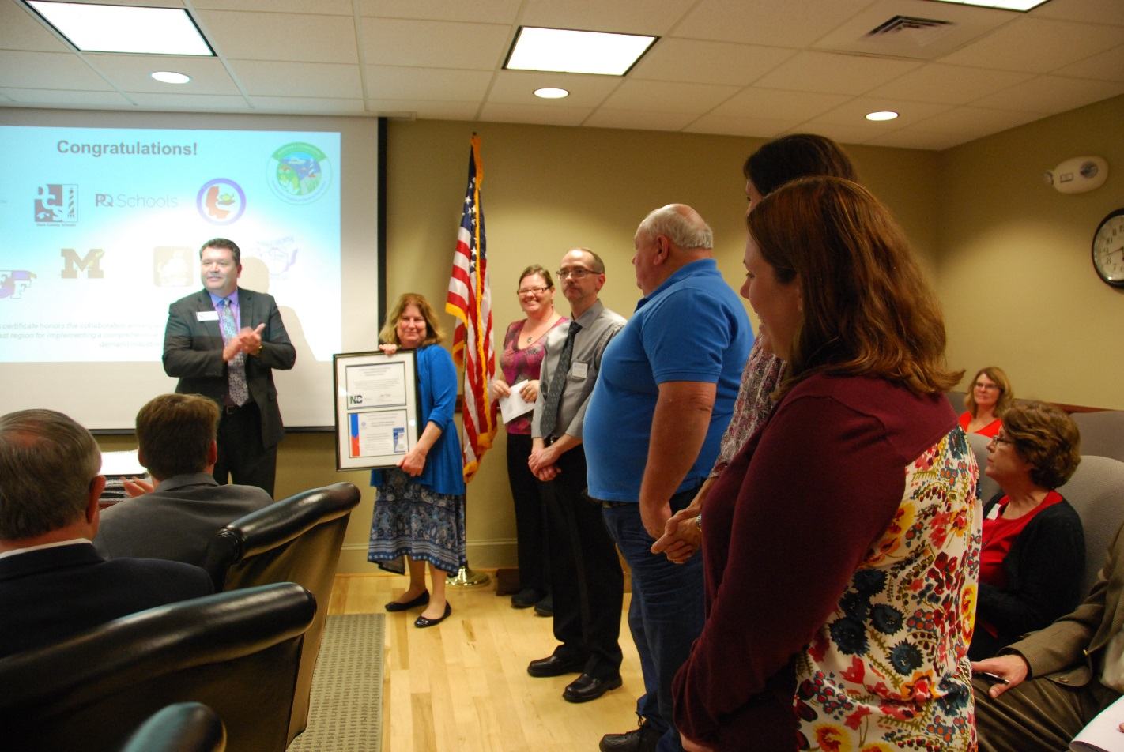
LOCAL IMPLEMENTATION

Slide 43
LOCAL IMPLEMENTATION

Slide 45
You are here!
Lou Stout
Emily
Nicholson
Room 101
Michael Williams
Room 105

Slide 46
Upcoming Events
Career Pathways Training 2018 State of the Region
Friday, March 16 9:30am-12pm Tuesday, April 10 9am-1pm
NCWorks-Beaufort County Hilton in Greenville
NCWorks Champions Meeting Transportation Industry Roundtable
Friday, March 23 10am-12pm Friday, May 25 10am-12pm
NC TeleCenter, Williamston Beaufort County Community College
NCETA Conference **Traitify Training - TBD
April 4-6 **Visit website calendar for more events
Wilmington, NC **Share your events with Brandi for website

